Slide 1


Toxic Comment Classification
Advanced Topics in Web Science Seminar
WS 2018/2019
Done by:
Marouene Zouaoui
Supervised by:
Dr. Adamantios Koumpis

Slide 2
Plan
Problem Statement
Literature Review
Data Description
Basic Exploratory Data Analysis
Feature Engineering
Classification Approach
Results
Future Plan

Slide 3
Problem Statement
Unfortunately, Social media platforms enable several problems, such as online harassment.
Recently, Google and Jigsaw started a project called Perspective, which uses machine learning to automatically detect toxic language.
A demonstration website has been also launched https://www.perspectiveapi.com/ which allows anyone to type a phrase in the interface and instantaneously see the toxicity score.

Slide 4
Literature Review
So far, Jigsaw and Google have built a range of publicly available models served through the Perspective API, including toxicity.
But the current models still make errors like Susceptibility to false alarm, Robustness to random misspellings as mention in their research paper.
Through this competition, they have proposed a challenge on Kaggle to build a multi-headed (multi-labeled) model that is capable of detecting different types of toxicity.

Slide 5
DataSet Description
The problem has only one predictor variable, 'comment_text', which is to be labelled or classified with respect to six target variables.
The target variable are the following types of toxicity:
Toxic
severe toxic
Obscene
Threat
Insult
identity hate
Notes:
Competition data set is available at Kaggle. A large number of Wikipedia comments are provided which have been labeled by human raters for toxic behavior.

Slide 6
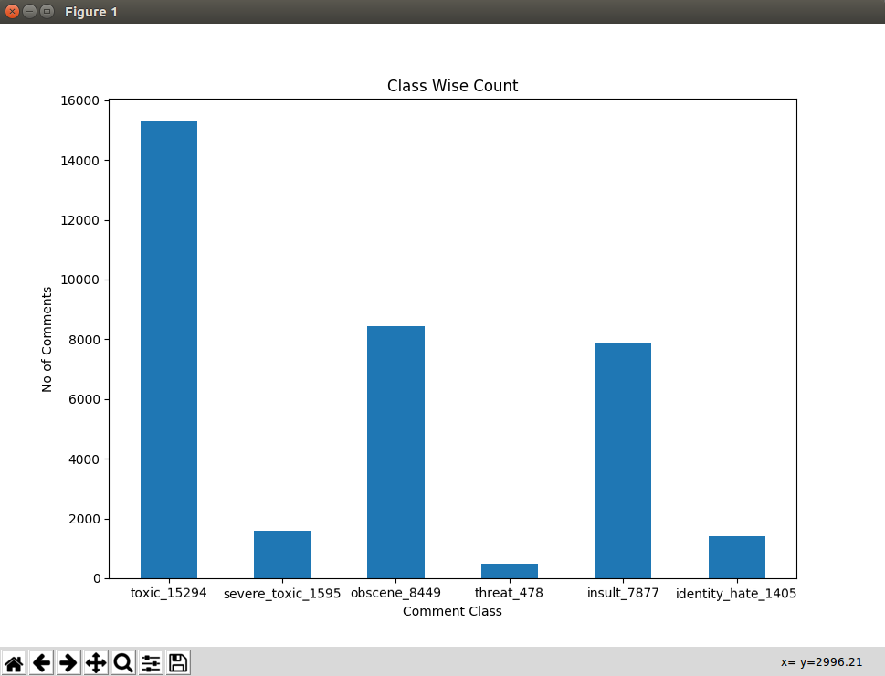
Basic Exploratory Data Analysis

Slide 7
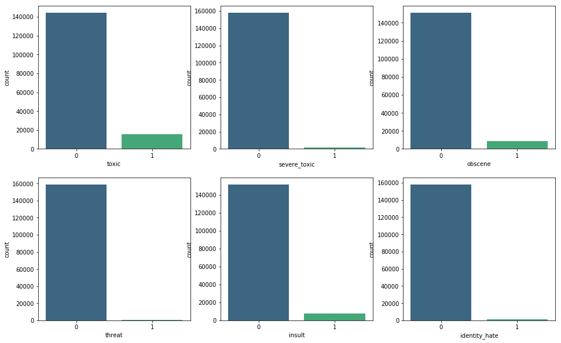
Basic Exploratory Data Analysis

Slide 8
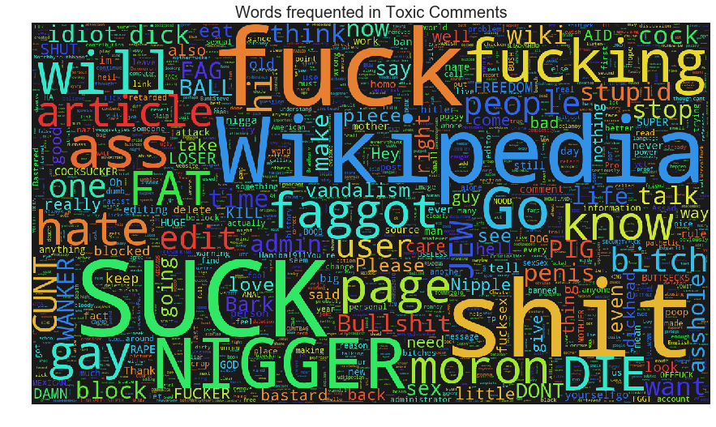
Basic Exploratory Data Analysis

Slide 9
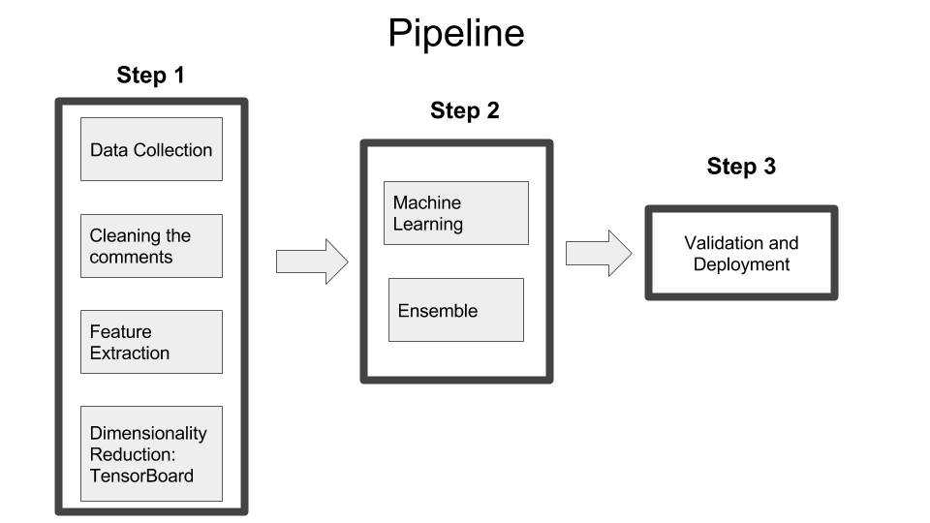
Pipeline

Slide 10
Preprocessing
Data Collection: using the dataset provided from Kaggle: Toxic Comment Classification Challenge
Cleaning text: Removing all irrelevant characters such as any non alphanumeric characters, Convert all characters to lowercase, Tokenizing comments into individual words , lemmatization and Stemming

Slide 11
Feature Engineering
Feature generation techniques:
Bag of Words (Count vectorizer)
Term frequency–inverse document frequency(tf-idf)
Word2Vec
Notes:
Generating features is important step to a good predictive model. They are many way to generate feature vector from text. However, they are few methods to assess the quality of the generated features.

Slide 12
Classification approaches:
For this project, I used 2 approaches:
Simple Machine Learning Approach
Deep Learning Approach

Slide 13
Simple Machine Learning Approach
Transforming the problem to a single label classification problem:
Binary Relevance: In this labels are treated independently i.e., for each label, a classifier is trained on the input data. Since, we have six labels, we would have six different classifiers.
Classifier Chains: In this, the first classifier is trained just on the input data and one label and then each next classifier is trained on the input space and all the previous classifiers in the chain.
Notes:
Since we have mutlitple labels, we are dealing with Mulit-label classification model. We can approach this problem in different way, some of which used in this project are

Slide 14
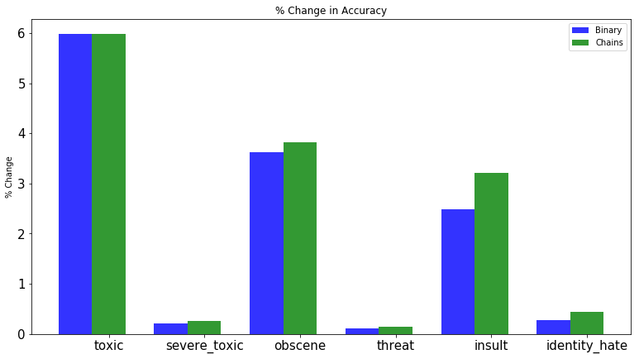
Simple Machine Learning Approach
Notes:
Since we have mutlitple labels, we are dealing with Mulit-label classification model. We can approach this problem in different way, some of which used in this project are

Slide 15
Simple Machine Learning Approach
Accuracy:
Using Ensembleing methods, Mean column wise(sum of all labels) area under receiver operating characteristic curve is 0.9555 on the Kaggle Leaderboard(Ongoing) is achieved.
Current placed in top20% on Kaggle leaderboard.
Notes:
Since we have mutlitple labels, we are dealing with Mulit-label classification model. We can approach this problem in different way, some of which used in this project are

Slide 16
Deep Learning Approach
For this approach, I used CNN with Word Embedding (i.e. Glove).
This Approach takes into consideration the relation between the words.
So the position and the context of the word have weights.

Slide 17
Deep Learning Approach
To build the CNN Model, I used Keras.
I selected binary_crossentropy as loss function and adam as optimizer after trying different functions in order to select the best combination.

Slide 18
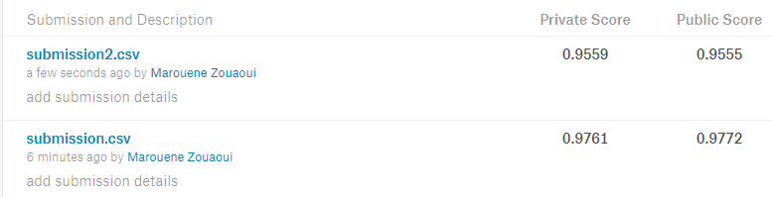
Results on Kaggle
I submitted the two approaches on Kaggle:
Submission.csv is for Deep Learning Approach.
Submission2.csv is for Simple Machine Learning Approach.

Slide 19
Future Plan
I am willing to use enhance the Deep Learning approach by using other type of word embeddings like FastText.
Deploy the program on the internet as a web aplication so that the users reviews and the label(toxic or non toxic) specified by users are stored in database which can be used to train the model on.

Slide 20
Thank You..!

